Slide 1

Emotional Recognition using facial expressions and speech analysis
HAMIDPUR, DELHI 110 036
Affiliated to
GURU GOBIND SINGH INDRAPRASTHA UNIVERSITY Sector - 16C Dwarka, Delhi - 110075, India 2017-21
HMR INSTITUTE OF TECHNOLOGY & MANAGEMENT
MINOR PROJECT
Submitted to:
Ms. Teena Verma
(Project Guide)
Submitted by:
Abhinav K.Gupta
Sahil Niranjan
Vinay Kumar
Yash Vashist

Slide 2

What is EMOTION?
Emotions are reflected in voice, hand and body gestures, and mainly through facial expressions
There are six types of emotions
Anger
Fear
Disgust
Happy
Sad
Surprise

Slide 3
Importance of emotion recognition
Human beings express emotions in day to day interactions.
Understanding emotions and knowing how to react to people’s expressions greatly enriches the interaction

Slide 4
Speech recognition

Slide 5
Speech Emotion Recognition, abbreviated as SER, is the act of attempting to recognize human emotion and affective states from speech. This is capitalizing on the fact that voice often reflects underlying emotion through tone and pitch.
Using librosa technique for it. librosa is a python library for analyzing audio and music.

Slide 6
We know that voice-controlled personal assistants such as Amazon Alexa, Apple Siri, and Google Assistant and many more have become more powerful and still evolving. We start to see them integrated into phones, laptops, kitchen gadgets, cars, basically on almost anything we use daily.
Applications

Slide 7
Factors of Speech Emotion Recognition
There are usually 3 main steps for speech emotion detection: signal processing, feature exaction and selection, as well as classification.
In the first step, the acoustic signal is processed and segmented into smaller units.
In the second step, the features of these small units were extracted and selected to represent different emotions.
Finally, in the classification step, models are trained with emotion labels and then used to predict the emotion of a new instance.

Slide 8
Steps we Followed TimeDistributed
convolutional neural network (CNN)
1- Voice Recording
2- Audio Breaking (Discretization)
3- Log-me-Spectrogram (Sound filtering)
4- Filtered audio splitting in equal size
5- Prediction using Pre-trained Model
6- Finalizing

Slide 9
About Dataset
The data set used for training is the "Ryerson Audio-Visual Database of Emotional Speech and Songs": https://zenodo.org/record/1188976#.XA48aC17Q1J
Contains 24 professional actors (12 female, 12 male)
North American accent
expression is produced at two levels of emotional intensity (normal, strong), with an additional neutral expression.

Slide 10
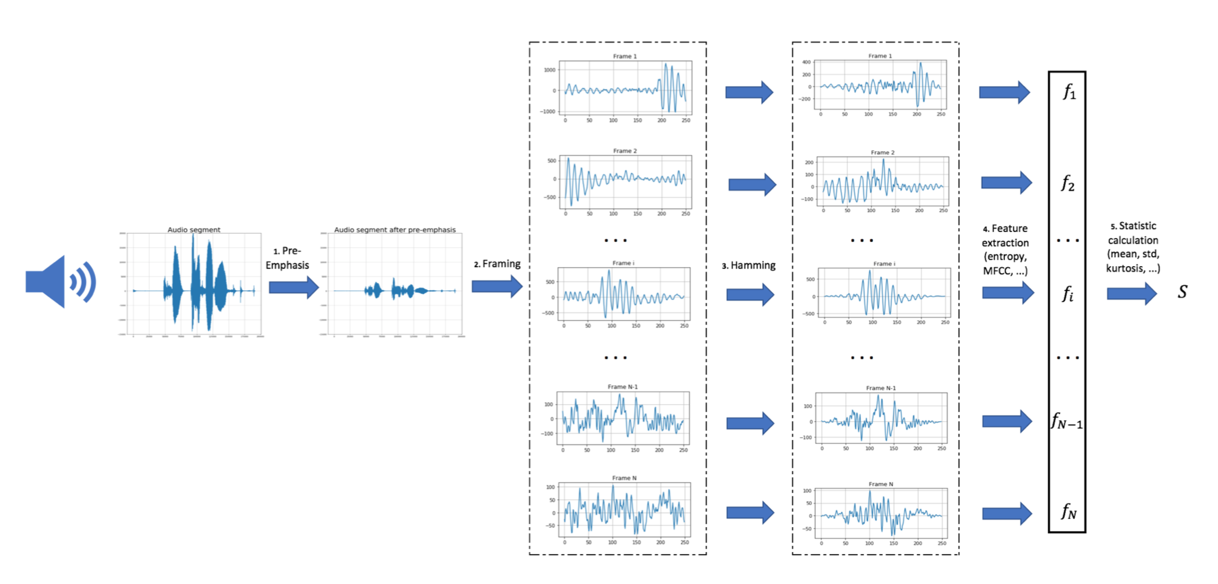
Flow Chart

Slide 11
Flow Chart Explained
Audio Segment- The main purpose of audio segmentation is to obtain a set of labels in order to separate an audio signal into homogeneous regions and classify them into a predefined set of classes, e.g., speech, music or noise.
PreEmphasis- intentional alteration of the relative strengths of signals at different frequencies(as in radio and in disc recording) to reduce adverse effects (as noise) in the following parts of the system.
Framing- The problem framing process involves defining the data collection process.
Hamming- The Hamming window is a taper formed by using a raised cosine with non-zero endpoints, optimized to minimize the nearest side lobe. function chosen to minimize the height of the highest sidelobe
Feature extraction
Static calculation for results

Slide 12

PROJECT SNAPSHOTS

Slide 13

Front End

Slide 14

Audio Page 2

Slide 15

Back End

Slide 16

Back End Audio Emotion Analysis Code

Slide 17
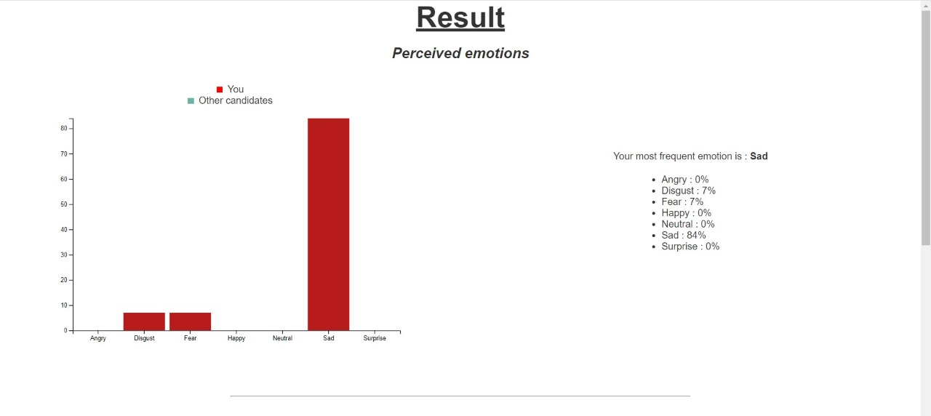
Results

Slide 18
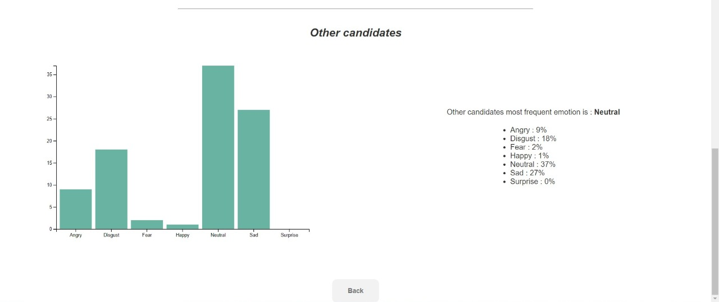

Slide 19
FACIAL EXPRESSION RECOGNITION

Slide 20
Face detection has been around for ages. Taking a step forward, human emotion displayed by face and felt by brain, captured in either video, electric signal (EEG) or image form can be approximated.
This can be helpful to make informed decisions be it regarding identification of intent, promotion of offers or security related threats. Recognizing emotions from images or video is a trivial task for human eye, but proves to be very challenging for machines and requires many image processing techniques for feature extraction.Any detection or recognition by machine learning requires training algorithm and then testing them on a suitable dataset.

Slide 21
Human emotion detection is implemented in many areas requiring additional security or information about the person. It can be seen as a second step to face detection where we may be required to set up a second layer of security, where along with the face, the emotion is also detected. This can be useful to verify that the person standing in front of the camera is not just a 2-dimensional representation
We can generalize the emotion detection steps as follows:
1) Dataset preprocessing
2) Face detection
3) Feature extraction
4) Classification based on the features

Slide 22
Proposed Methodology
Capture Image
Image Pre-processing
RGB to gray scale conversion
Scale Normalization
Crop Feature Regions
Edge Detection
Prewitt edge detection
Facial Emotion Classification

Slide 23
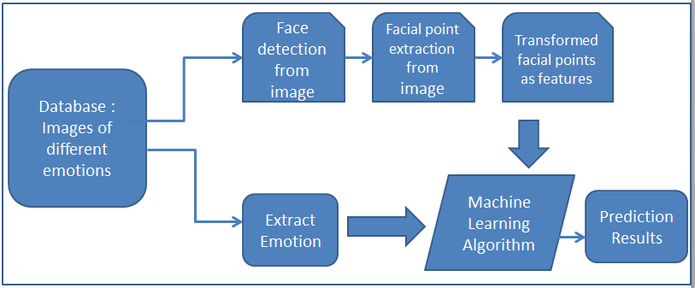
Methodology

Slide 24
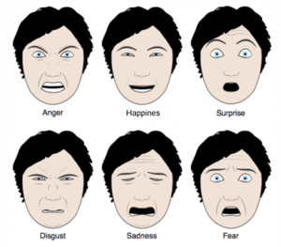
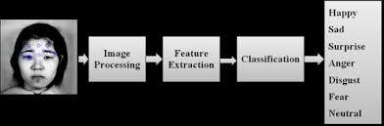
Working Methodology

Slide 25
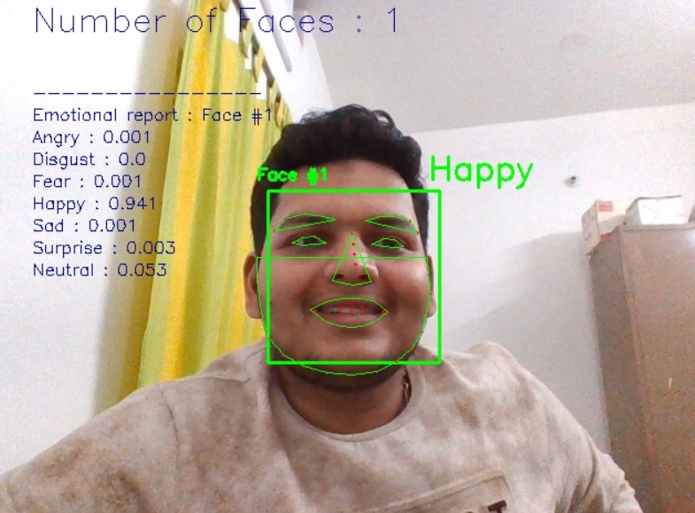
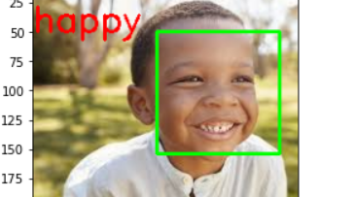
Though there are several types of input to the facial emotion recognition system, images containing faces are still essential to intelligent vision-based human computer interaction. Face detection tries to identify all image regions which contain a face regardless of its 3D position, orientation, and lighting conditions from a given image. The challenge here is that faces are non-rigid and have a high degree of variability in size, shape, color, and texture.

Slide 26

SNAPSHOTS

Slide 27



Slide 28
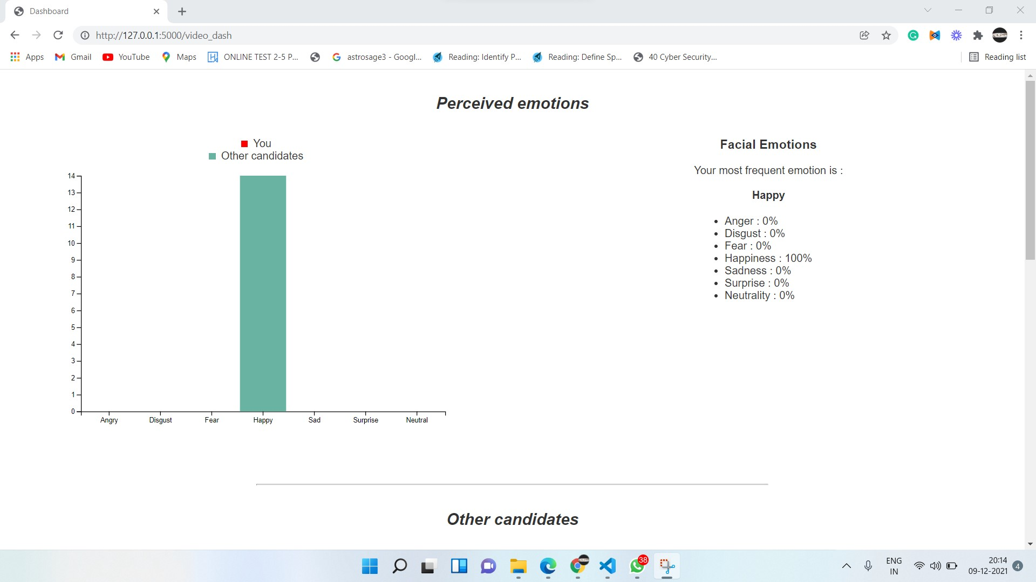

Slide 29
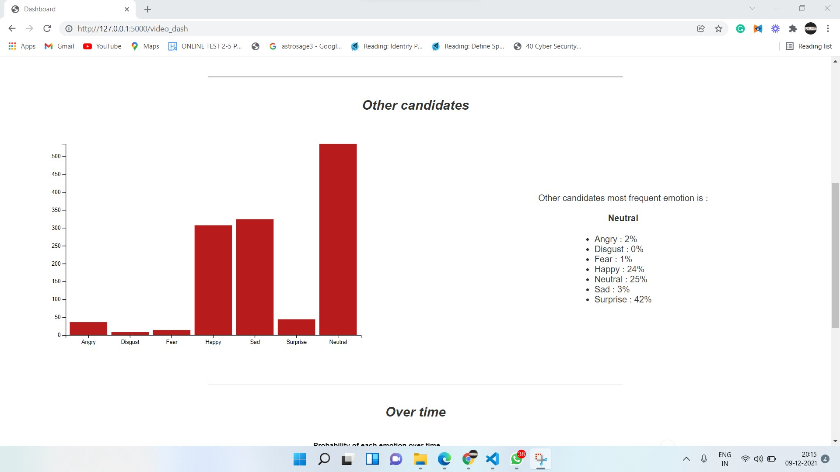
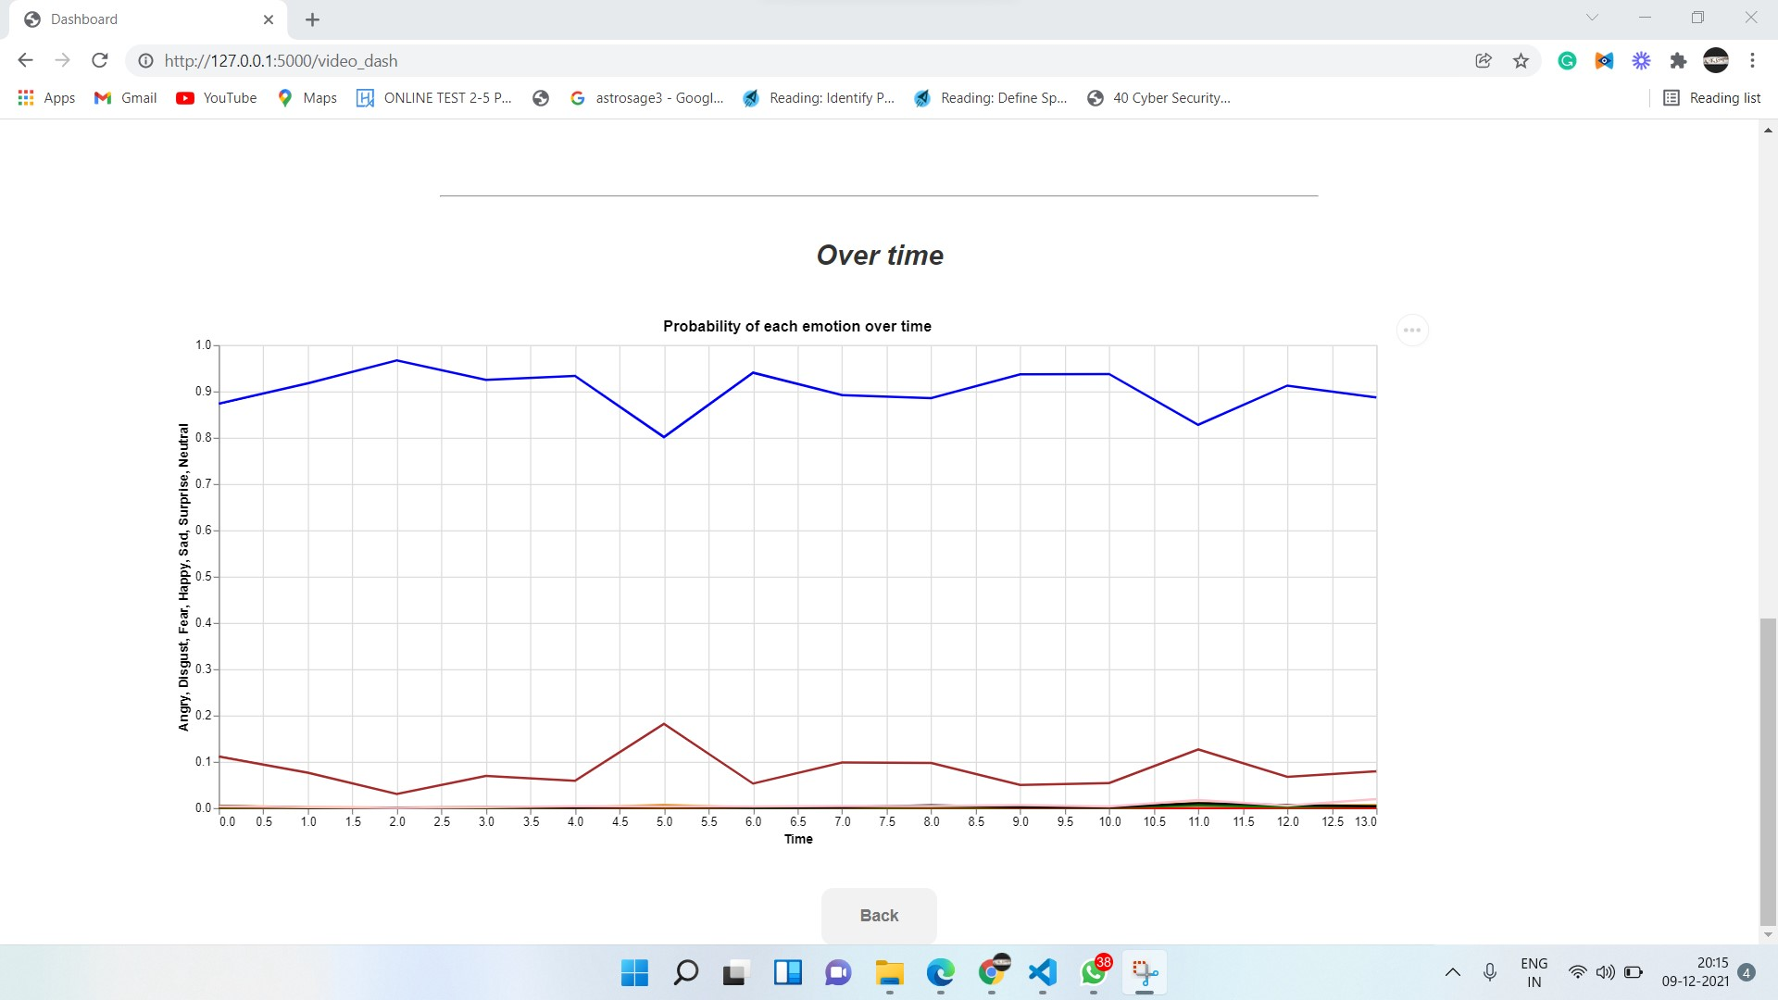

Slide 30
BENEFITS
Improved Public Security
Fast and Non-Invasive Identity Verification
Banking
Retail
Better Worker Attendance Systems
Face Recognition Furthers Enables Computer Vision

Slide 31
APPLICATIONS
Facial Authentication: Apple has brought in Face ID for Facial Authentication in iPhone. Some of the leading banks are trying to use Facial Authentication for lockers.
Customer Service: Some of the banks in Malaysia have installed systems which use Face Recognition to detect valuable customers of the bank so that the bank can provide the personalized service. This way, banks are able to generate more revenues by retaining such customers and keeping them happy.
Insurance Underwriting: Many insurance companies are using Face Recognition to match the face of the person with that provided in the photo ID proof. This way, the underwriting process becomes much faster.

Slide 32



TECHNOLOGIES
The project uses machine learning with python language . The implementation is in Jupyter Notebook. Following are the various packages that we have used in our project.
Librosa
Tensorflow
Deepface
Keras
Opencv

Slide 33
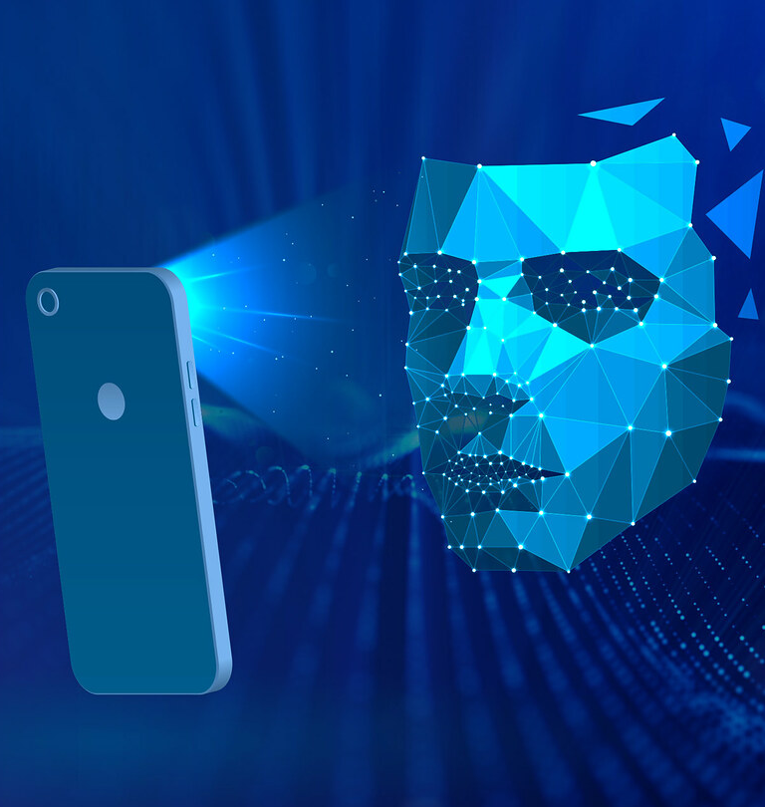
FUTURE SCOPE
The truth is that facial recognition and detection software is popping up everywhere. And this can be a really great thing.
Let’s say someone is trying to steal your identity or use photos of you under a different name online. With facial recognition technology, ideally, you could search the whole of the internet to see where each and every photo of your face is posted.
And apart from our lives on social media, facial recognition software can also offer protection from and prevention of other threats.
From using facial recognition in smart security cameras to its uses in digital medical applications, facial recognition software might help us in creating a safer, healthier future.

Slide 34
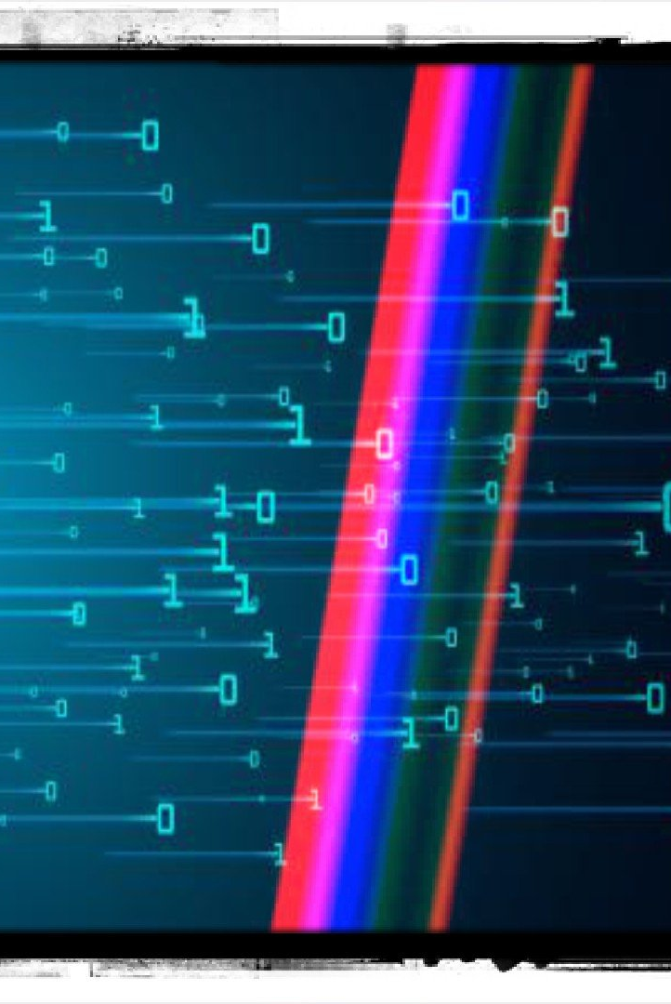
THANKYOU

